Slide 1
Chapter 3
Memory Management

Slide 2
Main Memory (RAM)
Main memory (RAM) is an important resource that must be carefully managed.
A program resides on a disk as binary executable file
To be executed the program must be brought into RAM
The CPU fetches instructions from RAM according to the value of the PC
The instruction operands may be needed to be fetched from RAM
After execution the results may be stored back to RAM

Slide 3
Memory Management
Ideally programmers want memory that is
  private
  large
  fast
  non-volatile
  cheap

Slide 4
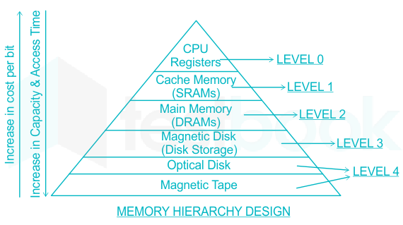
Memory Management
But in real world…
It is the job of the operating system to
  abstract this hierarchy into a useful model
  and then manage the abstraction.

Slide 5
Memory Management
The part of the operating system that manages the memory hierarchy is called the memory manager.
  Keep track of used memory
  Allocate memory to processes
  Deallocate it when they are done

Slide 6
Objective
In this chapter we will study
  how operating systems create abstractions from memory
  and how they manage them.
The focus will be on the programmer's model of main memory
Memory Abstraction: the view/illusion of the memory presented to the programmer by the OS

Slide 7
No Memory Abstraction
The simplest memory abstraction
Every program simply saw the physical memory
  MOV REG1, 1000
  move the contents of physical memory location 1000 to REGISTER1
Model of memory presented to the programmer is simply physical memory
Not possible to have 2 running programs in memory at the same time

Slide 8

No Memory Abstraction
Three simple ways of organizing memory with an operating system and one user process

Slide 9
Running Multiple Programs Without a Memory Abstraction
Used in the early models of the IBM 360.
Memory can be divided into 2-KB blocks and each one was assigned a 4-bit protection key held in special registers inside the CPU.
The PSW (Program Status Word) also contained a 4-bit key.
The hardware trapped any attempt by a running process to access memory with a protection code different from the PSW key.

Slide 10
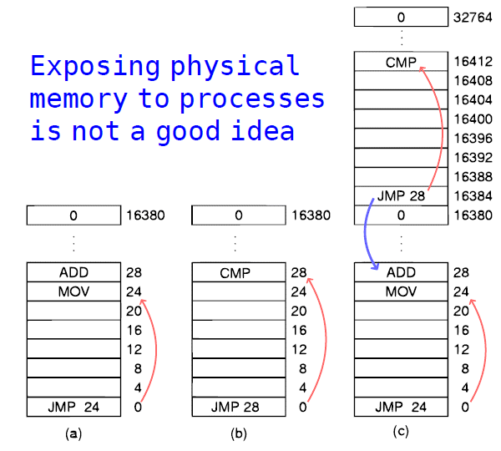
Running Multiple Programs Without a Memory Abstraction
Relocation
problem

Slide 11
Conclusion
Exposing physical memory to processes has several major drawbacks.
  if user programs can address every byte of memory, they can easily trash the operating system intentionally or by accident
  it is difficult to have multiple programs running at once

Slide 12
Conclusion
Two problems have to be solved to allow multiple applications to be in memory at the same time without interfering with each other
  protection
  relocation
SOLUTION
  invent a new abstraction for memory: the address space

Slide 13
A Memory Abstraction: ADDRESS SPACES
An address space is the range of addresses that a process can use to address memory.
  Just as the process concept creates a kind of abstract CPU to run programs,
  the address space creates a kind of abstract memory for programs to live in.
Each process has its own independent address space

Slide 14
A Memory Abstraction: ADDRESS SPACES
How to give each program its own address space??
  address 28 in one program means a different physical location than address 28 in another program

Slide 15
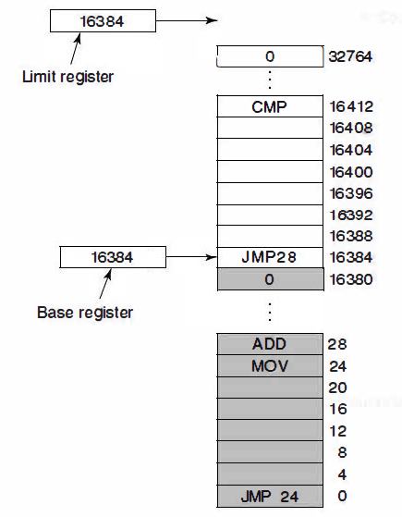
Base and Limit Registers (dynamic relocation)
  Base and limit registers
  can be used to give each
  process a separate
  address space
  CPU hardware
  automatically adds the
  base value to the
  address generated by the
  process
  JMP 28 => JMP 16412

Slide 16
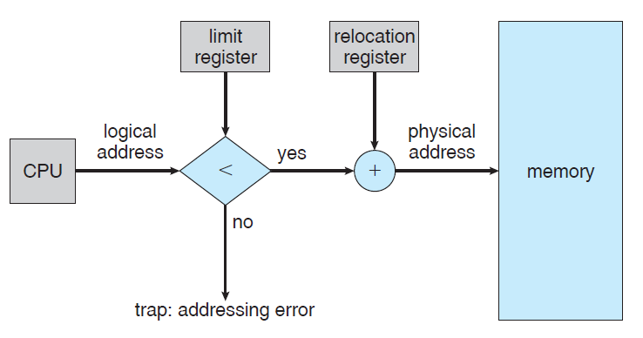
Base and Limit Registers

Slide 17
Disadvantage
An addition and a comparison on every memory reference.
- Comparisons can be done fast, but additions are slow due to carry-propagation time unless special addition circuits are used.

Slide 18
Memory Overload
In practice, the total amount of RAM needed by all the processes is often much more than can fit in memory.
Keeping all processes in memory all the time requires a huge amount of memory and cannot be done if there is insufficient memory.
Two approaches to solve
  Swapping
  Virtual Memory

Slide 19
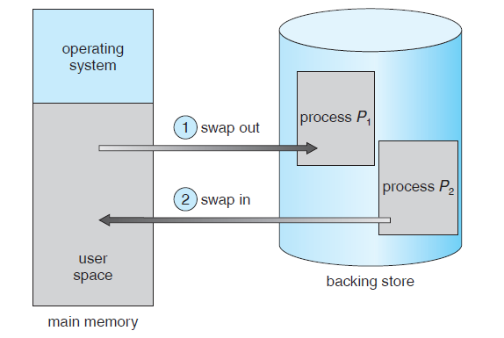
Swapping (1)
  Bringing in each process in its entirety,
  running it for a while
  then putting it back on the disk

Slide 20

Swapping
Memory allocation changes as
  processes come into memory
  leave memory
Shaded regions are unused memory

Slide 21
Contiguous Allocation in Swapping
  Hole – block of available memory; holes of various size are scattered throughout memory
  When a process arrives, it is allocated memory from a hole large enough to accommodate it
  Operating system maintains information about:
  a) allocated partitions b) free partitions (hole)
OS
OS
OS
OS
process 5
process 5
process 5
process 5
process 9
process 9
process 8
process 10
process 2
process 2
process 2
process 2

Slide 22
Swapping
When swapping creates multiple holes in memory, it is possible to combine them all into one big one by moving all the processes downward as far as possible.
This technique is known as memory compaction
It is usually not done because it requires a lot of CPU time.

Slide 23
Memory Layout for Process
∞
Stack
Data
Code
0
Slide <number>

Slide 24

Swapping
(a) Allocating space for growing data segment
(b) Allocating space for growing stack & data segment

